Slide 1
SQL – DataTypes, Operators, Functions
Key Concepts:
Strings
CHAR, VARCHAR, NCHAR, NVARCHAR
Pattern Matching
COLLATE
Predicates - IN, BETWEEN, LIKE
Relational, Logical & Arithmetic Operators
Mathmetical & Aggregate Functions
Three-Valued Logic & Nulls
Print (T-SQL)
Characterize the data you want as precisely as possible.

Slide 2
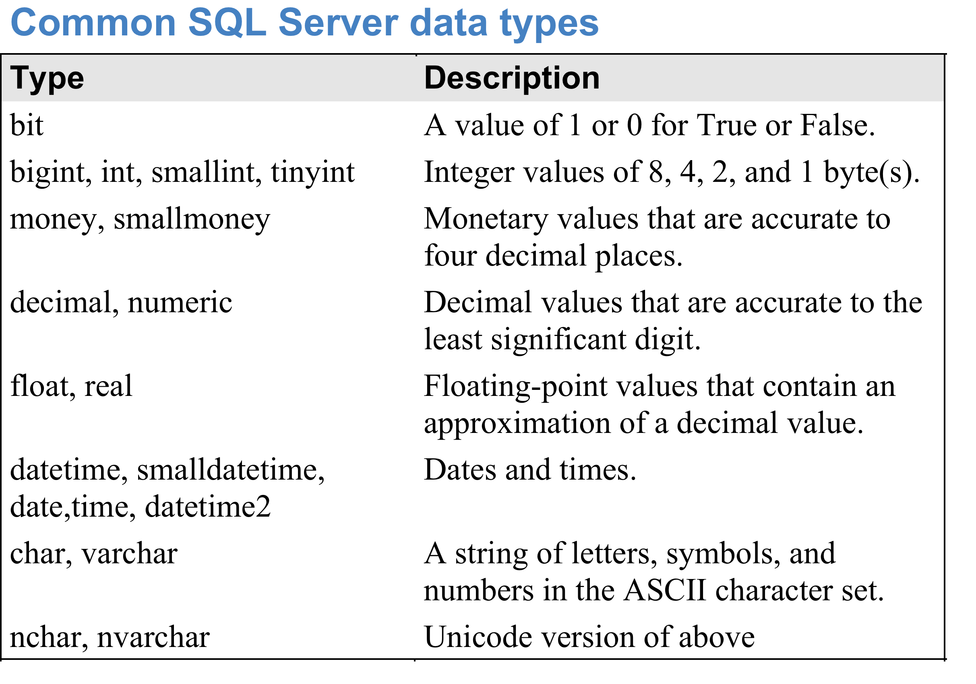
NOTE: With NUMERIC, specify the total number of places and the number of places
after the decimal point. Omitting these can cause problems.
Full list of data types is at
http://technet.microsoft.com/en-us/library/ms190309.aspx

Slide 3
Data Type Precedence
If data of 2 different types occurs in an expression, data of lower type precedence is automatically converted to the higher type precedence.
From highest to lowest:
Dates
Float
Real
Decimal
Numeric
Ints
Chars
The CAST and CONVERT functions can also be used to convert from one data-type to another.

Slide 4
Strings
Strings are denoted using single quotes.
Double quotes are used for irregular identifier names.
E.g. "name containing spaces".
To get a single quote inside a string, use 2 single quotes.
E.g. 'a quote: '' followed by some text'
SQL Server supports ASCII and Unicode character data types.
ASCII is CHAR and VARCHAR – 1 byte of storage per character.
Supports English & most Western European languages.
Unicode is NCHAR and NVARCHAR – usually 2 bytes of storage per character, sometimes 4 bytes per character.
Supports all languages.
Denoted by an N in front of the string; E.g. N'hello'

Slide 5
String Concatenation
String concatenation is performed using the + operator.
SELECT empid, firstname + ' ' + lastname AS fullname
Assuming the fields are CHAR or VARCHAR.
If using Unicode add an N in front of the character.
SELECT empid, firstname + N' ' + lastname AS fullname
Assuming the fields are NCHAR or NVARCHAR.
Concatenating anything to a NULL yields a NULL.

Slide 6
CONCAT Function
From SQL Server 2012 on, there is a CONCAT function that concatenates any sequence of values together (including NULLs) into a string.
E.g.
1 + '1' is 2,
while
CONCAT(1, '1') is 11.
'a' + NULL + 'b' is NULL,
while
CONCAT('a', NULL, 'b') is 'ab'

Slide 7
In-Built Functions
SQL has a HUGE number of in-built functions that perform many useful tasks on strings.
Removing spaces from the left or right end of strings
Extracting or replacing parts of a string
Reversing a string
….
We will not cover these explicitly in these slides – look them up whenever you need them.
E.g. RTRIM, LTRIM, SUBSTRING, LEFT, RIGHT, LEN, CHARINDEX, REPLACE, REVERSE, UPPER, LOWER, etc.
NOTE: In SQL strings start at position 1, not 0!
E.g SUBSTRING('abcdef', 2, 3) is 3 characters from position 2, so it returns 'bcd'.

Slide 8
Arithmetic Operators
Arithmetic operators: +, -, *, /, % (modulus - remainder after integer division).
If both operands are the same type, result is of that type.
Thus 5/2 is 2 .
If the operands are of different type, the one of lower type precedence is converted to the higher one.
E.g. 5 is INT, 2.0 is NUMERIC, so to compute 5/2.0, 5 is converted to NUMERIC, result is 2.5 (NUMERIC).
Integers can be cast to numeric type by using the CAST function and specifying the total number of digits as well as the number of digits after the decimal point.
E.g. if X and Y are integer attributes and you want a numeric division, do CAST(X AS NUMERIC(8,3)) / CAST(Y AS NUMERIC(8,3)); this gives 8 digits in total, 3 of which are after the decimal point.
Notes:
SQLPREDANDOP.SQL

Slide 9


Mathematical Functions
Mathematical Functions include:
ABS, POWER, SQUARE, SQRT, ROUND, RAND, ….
Note that ROUND truncates if the 3rd argument is not zero.
SELECT ROUND(1234.5678, 2) AS "2 Places",
ROUND(1234.5678, 1) AS "1 Place",
ROUND(1234.5678, -2) AS "2 Places on left",
ROUND(1234.5678, 2, 1) AS "Truncate";
RAND generates a float between 0 and 1.
SELECT CAST(RAND() * 10 AS INT) + 1 AS "1 to 10";

Slide 10
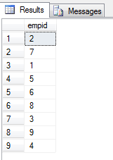
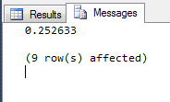
PRINT
T-SQL does have a PRINT command. The output appears in the “Messages” tab, not the “Results” tab.
PRINT(RAND())
SELECT empid
FROM HR.Employees

Slide 11
Aggregate Functions
An aggregate function operates on a column and returns a single value. The 5 aggregate functions are:
COUNT(column) counts the number of non-NULL values in column.
SUM(column) adds up the non-NULL values in column. Applies to numeric and money columns only.
AVG(column) computes the mean of the non-NULL values in column. Applies to numeric and money columns only.
MIN(column) finds the smallest non-NULL value in column. Applies to numeric, money, string and date columns.
MAX(column) finds the largest non-NULL value in column. Applies to numeric, money, string and date columns.

Slide 12
Nulls and Aggregate Functions
COUNT(column) counts the number of non-NULL values in column.
COUNT(*) counts the number of rows in a group, including rows containing NULL.
The number of NULLs in a column can be obtained by COUNT(*) – COUNT(column).
Or by using a WHERE …. IS NULL condition and then applying COUNT(*).
Note: Particularly when computing AVG, consider whether the NULLs should be included or not.
E.g. Assume some customers have been given a discount and we want to compute the average discount. Should customers with NULL discount be included in this average or not? Depends on context.

Slide 13
More about Aggregate Functions
Use DISTINCT to apply an aggregate function to distinct elements only.
E.g. if column X contains 3, 2, 2, 5, 2, 3 then:
SUM(X) returns 17.
SUM(DISTINCT X) returns 10 (3 + 2 + 5).
To filter rows based on an aggregate function value, use HAVING rather than WHERE.

Slide 14
Floating Point Averages
The AVG function adds up the non-NULL values and divides by their number. If the column is of integer type, the result is an integer division, which produces an integer result.
E.g. SELECT AVG(empid)
FROM HR.Employees
WHERE empid <= 4;
The result is 2 – the empids are 1,2,3,4, so their avg is 10/4.
If you want a floating point result, it doesn't help to convert the result of the AVG calculation, since it's an integer.
You need to convert the values being averaged.
SELECT AVG(CAST(empid AS FLOAT))
FROM HR.Employees
WHERE empid <= 4;
The result is 2.5, as desired.

Slide 15
Relational Operators
Relational operators include the standard ones:
= > < >= <= <> (not equal to)
There are also 3 non-standard ones in T-SQL:
!= !> !<
Three possible results: True, False, Unknown.
Any relational expression involving NULL yields Unknown.
Relational operators can also be applied to:
Strings (uses usual ASCII ordering of characters).
Dates (uses calendar order).
Note this includes times.
Relational expressions are used in clauses like WHERE, HAVING, etc.
Notes:
SQLPREDANDOP.SQL

Slide 16
Logical Operators
Usual Logical operators: AND, OR, NOT
E.g. Find all orders placed after Aug 23 2013 that were handled by the employees numbered 3, 4 or 8.
SELECT orderid, empid, orderdate
FROM Sales.Orders
WHERE orderdate >= '20130823' AND (empid = 3 OR empid = 4 OR empid = 8);
Remember: When mixing logical operators, parentheses matter!
E.g. cond1 AND cond2 OR cond3 is not the same as
cond1 AND (cond2 OR cond3)
Notes:
SQLPREDANDOP.SQL

Slide 17
Pattern Matching
% (percent) represents a string of any length, including 0.
E.g. 'D%' matches Davis, Dean, D, etc.
_ (underscore) represents a single character.
E.g. '_e%' matches if the second character is 'e': Dean, Bet, Teen, etc.
[<list of possible characters>] represents a single character that must come from the specified list.
E.g. '[ABC]%' is either A, B, or C followed by anything: Able, Brittain, Carol, etc.
[<character> - <character>] represents one of a range of characters.
E.g. '[A-E]%' is either A, B, C, D, or E followed by anything: Able, Brown, Ellis, etc.
^ inside square brackets represents "not".
E.g. '[^A-E]%' represents anything that is NOT from A-E, followed by any string: Frank, Willow, etc.

Slide 18
Pattern Matching Examples
D% matches any string of any length starting with D (including 'D').
D_ matches any 2-character string starting with D.
D_% matches any string starting with D containing at least one other character (thus 'D' would not match).
De% matches any string starting with D followed by e.
D_e% matches any string with first letter D and 3rd letter e.
[DE]% matches any string starting with either D or E.
[ABC]%[abc] matches any string starting with either A, B or C, followed by any characters, ending with either a, b or c.
E.g America, Club, Ba, ...
%a%a% matches any string containing at least 2 a's.
[1-9][0-9] matches any 2 digit number.
_%@_%.[a-z][a-z][a-z] matches any email address (the name and organization must be at least one character, the domain [the part after the period] must be exactly 3 letters.

Slide 19
COLLATE
Pattern matching is case-sensitive.
E.g. a% does not match Able.
However, if the database’s collation settings are set so that its contents are not case-sensitive, then, for example, a% would match Able.
In this case, the COLLATE clause can be used to make a case-sensitive query. Specify the alphabet being used; e.g. Latin1_General.
E.g. SELECT empid, lastname
FROM HR.Employees
WHERE lastname COLLATE Latin1_General_CS_AS = 'able';
Here _CS refers to "Case-Sensitive" and
_AS refers to "Accent-Sensitive"
e.g. Ä and Á will treated as different.

Slide 20
Predicates – IN, BETWEEN
Predicates are used in clauses like WHERE, HAVING, etc.
Three possible results: True, False, or Unknown.
IN returns True if expression is equal to at least one member of a set.
E.g. WHERE name IN ('Bob', 'Pat', 'Chris')
Equivalent to:
WHERE (name = 'Bob') OR (name = 'Pat') OR (name = 'Chris')
BETWEEN returns True if expression is in a range, including specified boundary values.
E.g. WHERE orderid BETWEEN 100 AND 200
Note the use of AND here. This is NOT the logical operator AND.
Equivalent to WHERE 100 <= orderid AND orderid <=200
This AND is the logical operator AND!
Notes:
SQLPREDANDOP.SQL

Slide 21
Predicates - LIKE
LIKE returns True if a string matches a pattern.
E.g. WHERE lastname LIKE '[A-M]%'
will match all lastnames starting with any letter from A to M.
NOTE: Don’t use LIKE when = works!
E.g. use lastname = 'Jones'
instead of lastname LIKE '[Jones]'
Similarly, don’t use NOT LIKE when <> or != works!
Notes:
SQLPREDANDOP.SQL

Slide 22
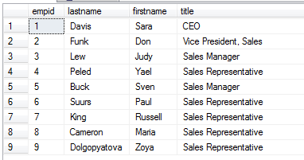
Characterize Data Precisely
When writing a query to extract data, characterize the data you want as precisely as possible.
E.g. We want to get the names of all sales managers and sales representatives from the following table.
Which of the following is preferable?
WHERE title = 'Sales Manager' OR title = 'Sales Representative'
WHERE title LIKE 'Sales%'
WHERE title LIKE 'S%'
WHERE title NOT LIKE 'CEO' AND NOT LIKE 'Vice%'
Note that for this data, all these conditions produce the same results.

Slide 23
Characterize Data Precisely
title = 'Sales Manager' OR title = 'Sales Representative' characterizes the data we want exactly.
title LIKE 'Sales%' is not as good because if there were other employee types starting with 'Sales' (e.g. 'Salesperson') they would be included, which we don't want.
title LIKE 'S%' will fail if employees are added whose title begins with S (e.g. Surveying).
title NOT LIKE 'CEO' AND NOT LIKE 'Vice%' will fail if employees are added who are not in Sales but who are not CEO or start with Vice.

Slide 24
Operator Precedence
() (Parentheses)
* (Multiplication), / (Division), % (Modulo),
+ (Positive), -(Negative), +(Add), +(Concatenate), -(Subtract)
=, >, <, >=, <=, <>, !=, !>, !<
NOT
AND
BETWEEN, IN, LIKE, OR
= (Assignment)
Always use parens to clarify the order you want.
Notes:
Last three comparison operators SQL Server specific
SQLOpPreced.sql

Slide 25
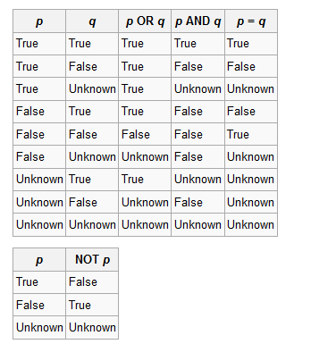
Logical Operators – 3-Value Logic
Notes:
SQLPREDANDOP.SQL

Slide 26
3VL and Null
What is the result of 5 IN (3, 6, Null)?
This means (5 = 3) OR (5 = 6) OR (5 = Null)
i.e. False OR False OR Unknown
i.e. Unknown
Note that 5 NOT IN (3, 6, Null) is also Unknown.
It is Unknown if something is IN, or NOT IN, any set containing Null.
Similarly, NULL = NULL is Unknown.
Use ISNULL and IS NOT NULL to check if something is NULL.

Slide 27
Accept True
Some language elements in SQL, including WHERE and HAVING, are ‘accept True’ - treat as true only cases where the test evaluates to TRUE and reject FALSE and UNKNOWN.
E.g. SELECT Name FROM Table WHERE ClassID = ClassID
This does NOT return all the names. Hedda Lettuce is excluded, because the test returns UNKNOWN, and the WHERE rejects it.
Name | Class ID
Jerry Attrick | CIS 255
Tommy Gunn | CMSC 250
Hedda Lettuce
Rose Bush | CMSC 250
Cara Van | CIS 255

Slide 28
Accept False
Other language elements, e.g. check constraints (a constraint placed on data values to ensure validity) are 'accept False' - treat as True cases where the test evaluates to TRUE or UNKNOWN and reject only False.
E.g. 0 <= age AND age <=120 will allow a NULL age, because the condition evaluates to UNKNOWN.
E.g. If an attribute allows nulls and has a check constraint that values must be positive, nulls can be placed in that column.

Slide 29
Nulls
NULL = NULL evaluates to UNKNOWN.
SQL provides the IS NULL and IS NOT NULL predicates to check whether something is or is not NULL.
E.g. Suppose we want all the people whose manager isn't 'Bob', including people who have no manager.
WHERE manager <> 'Bob' will NOT work!
If the manager is NULL this returns Unknown, so is not included.
Need to explicitly check for the NULL.
The following works:
WHERE manager <> 'Bob' OR manager IS NULL

Slide 30
How Nulls Behave
Different language elements treat NULL differently.
GROUP BY and ORDER BY treat 2 NULLS as equal and group them together.
Other language elements (e.g. WHERE) treats 2 NULLS as not equal.
Note that ORDER BY puts NULLS first (in ascending order).
NULLs can be a source of errors!
It is always desirable to reduce the number of NULLs in the database.
We will see how to design databases to avoid NULLs.
Sometimes NULLs cannot be avoided.
E.g. Not everyone has a middle-initial.
If you have to indicate the absence of a value, use NULL rather than something else, like '' or 'N/A' or 'None'.

Slide 31
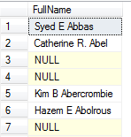
Concatenating with NULL
Anything concatenated to NULL is NULL.
E.g.
SELECT FirstName + ' ' + MiddleName + ' ' + LastName AS FullName
FROM Person.Person;
All the people whose middle-name is NULL
end up with NULL as their full-name!
To fix this, use either:
ISNULL(value, replace) replaces value by replace if value is NULL.
COALESCE(value₁, …, value_{n}) returns the first value that is not NULL.

Slide 32
Concatenating with NULL
All the following work.
However people with NULL middle-names end up with TWO spaces between their first and last-names. Can you fix this?
SELECT FirstName + ' ' + ISNULL(MiddleName, '') + ' ' + LastName
AS FullName
FROM Person.Person;
SELECT FirstName + ' ' + COALESCE(MiddleName, '') + ' ' + LastName AS FullName
FROM Person.Person;
SELECT CONCAT(FirstName, ' ', MIDDLENAME, ' ', LastName)
AS FullName
FROM Person.Person;

